Slide 1


AirBridge
Team Infernals

Slide 2
Problem
Lack of MacOS to android compatibility
Inability to share data like photos between MacOS and other non-Apple devices.
People would have to change to their device to an Apple device if they switch to MacOS just to do basic daily tasks.

Slide 3

Our Solution
We developed a simple workaround a transferring files from any device to another, which in this case will be helpful for file sharing between MacOS and Android both ways

Slide 4






How we did it?
Hosts a website with directories on local wifi
We scrape data from that website using python requests library
Server (phone)
The PC
We put that into beautiful soup to filter it
Then we use GUI to navigate
Curl Is used to download files

Slide 5
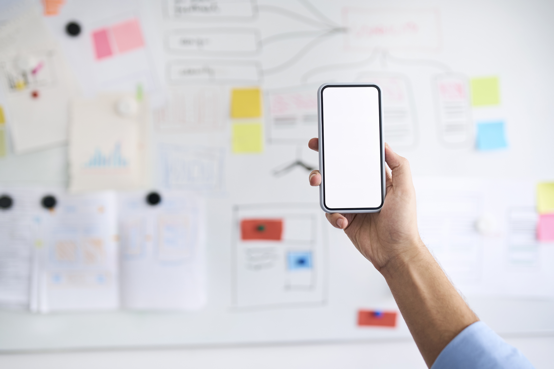
THANKS FOR LISTENING
Team Infernals

